Slide 1
Higher Education in Germany and Spain
30.3.2021
G.T. College

Slide 2
G.T. (Ellen Yeung) College, March 30
Studying in Germany
Manuel Grösch
Contact: info@hongkong.diplo.de

Slide 3
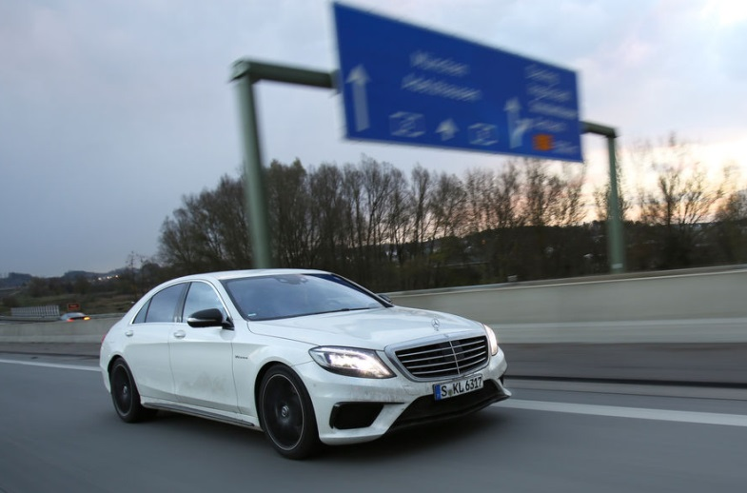
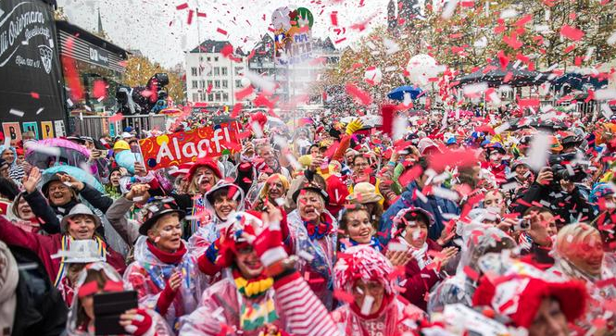
Why should I choose Germany?

Slide 4
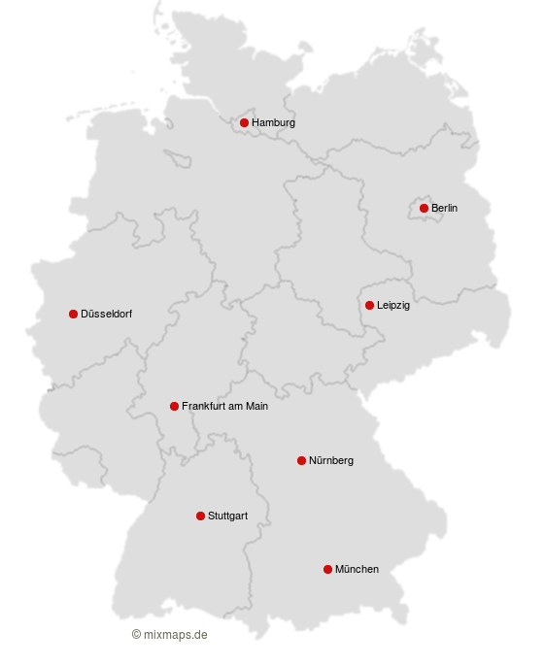
Living in Germany
16 federal states with a distinct regional identity, different educational systems
Highly developed:
quality of life, human development, press freedom, democratic norms, low corruption and crime rate
Good work-life balance: 41-hour work week, guaranteed 30 annual leave days, well-organized social security

Slide 5
Studying in Germany:
High Quality - Low Cost
24 universities in the Top 200 worldwide
Low to no tuition fees
Low cost of living (avg. 8000 HKD)
Good student housing
Many study
programmes
conducted in English
Great variety of programmes and majors

Slide 6
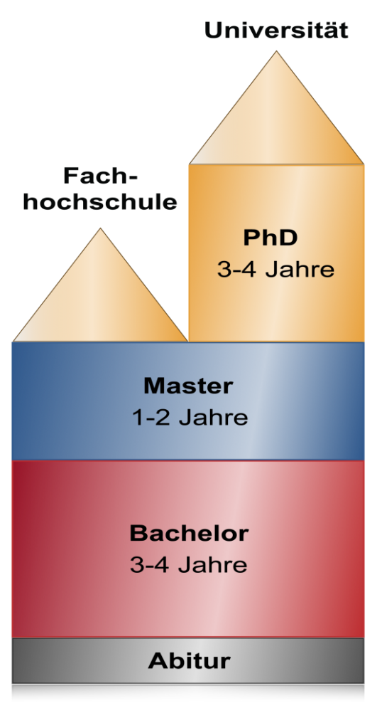
The German Degree System at a glance
Bachelor's Degree (3 and 4-year programmes)
Master's Degree (1; 1,5 and 2-year programmes)
BA/BSc and MA/MSc consecutive 5 years
PhD Degree (3 to 5 years, structured programme or individual doctorate)
State Exams for the medical and legal professions

Slide 7
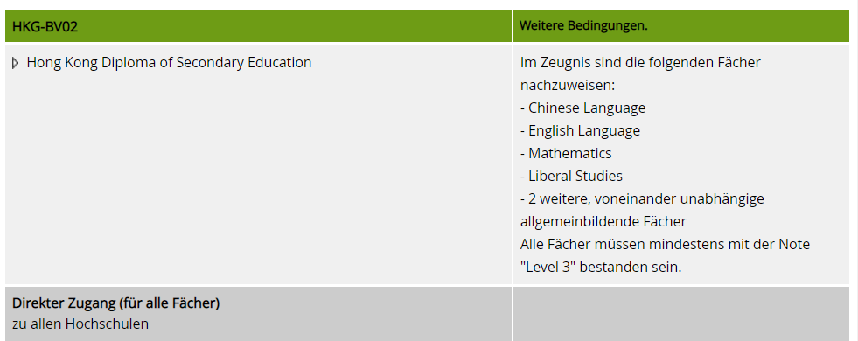
Conditions for Students from Hong Kong
direct admission to university
all mentioned subjects
have to be „Level 3“ or above

Slide 8
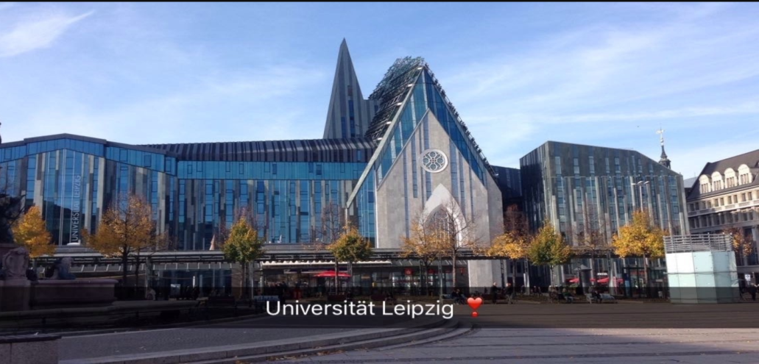
Universities
Focus on theoretical knowledge
Compulsory courses, but also many electives
Research oriented, a research-based final thesis
Sometimes very large institutions with up to 50,000 students

Slide 9
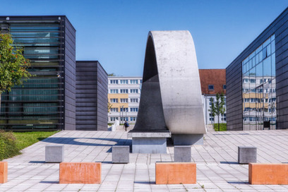
Universities of Applied Sciences
應用科學大學 (應用科技大學)
Focus practical application and strong links to the corporate world
Set course groups, stronger student-professor relationship
Degrees available: Bachelor's, Master‘s, PhD (in cooperation)
Often smaller regional Universities
Westsächsische
Hochschule
University of Applied
Sciences Zwickau

Slide 10
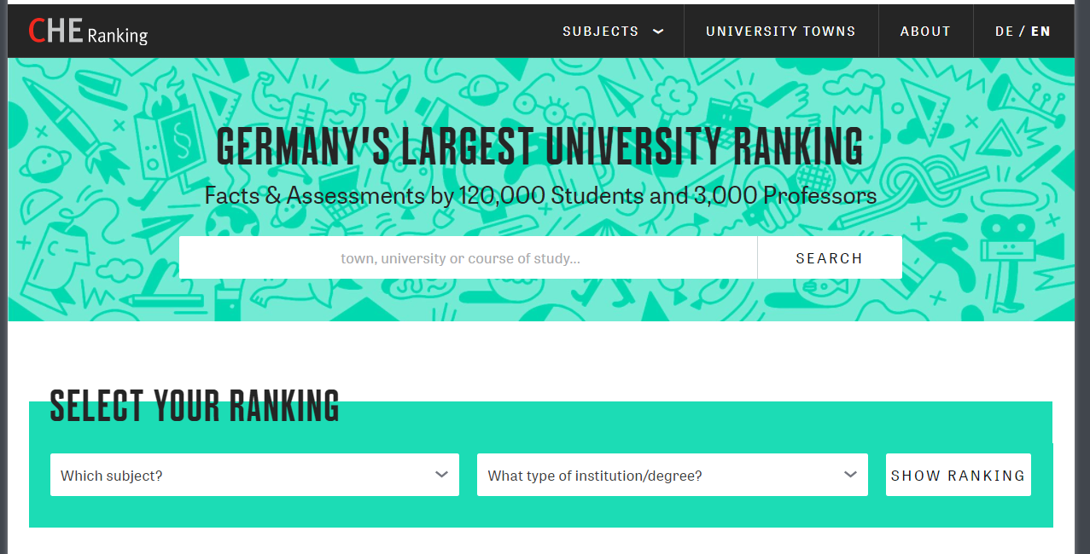
How do I find the Best German University?

Slide 11
International Programmes
Courses taught in English
No need to show proof of any German language skills
International Programmes at all levels across Germany
Bachelor's, Master's or structured PhD programmes
Internationally recognised degrees
Intensive support for international students
www.daad.de/international-programmes

Slide 12
Goethe-Institut Hong Kong 28. May 2020

Slide 13
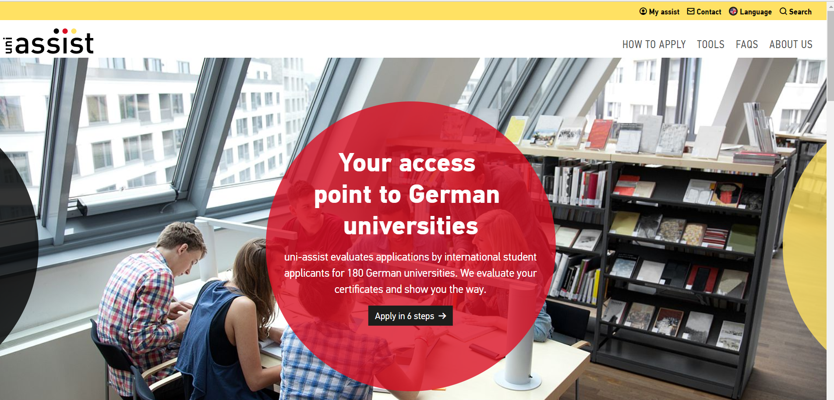
How to apply

Slide 14
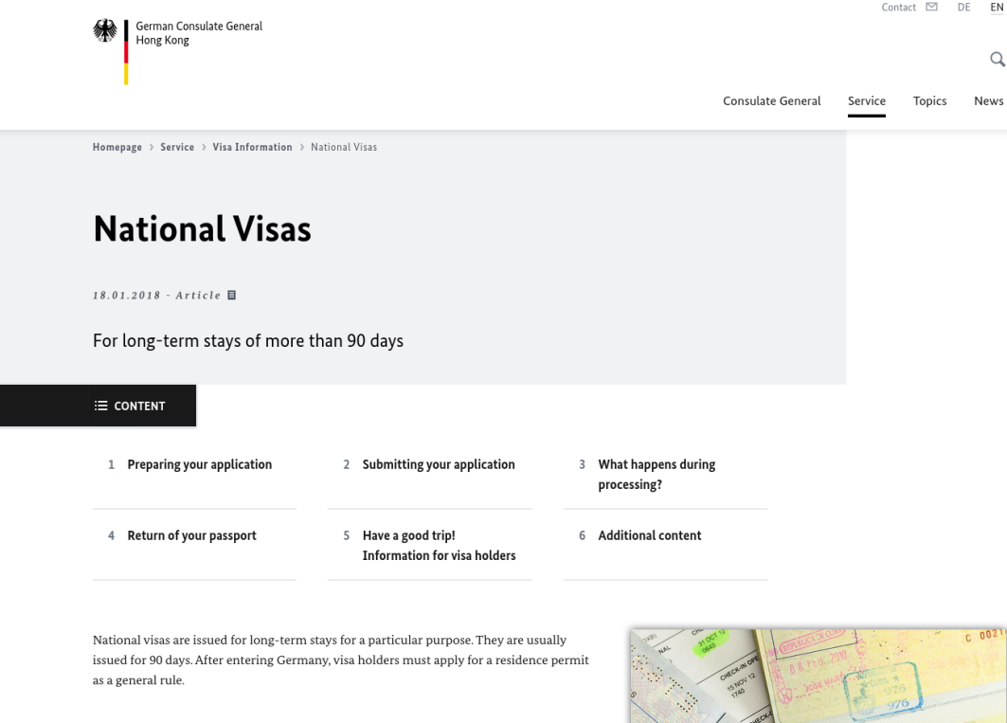
Visa application
More information, checklists, links:
https://hongkong.diplo.de

Slide 15
Visa application - FAQ
Can I work while studying?
Foreign students are allowed to work 120 full days or 240 half-days – more if they have jobs as student or graduate assistants.
Can I work in Germany after graduating?
You have 18 months after graduation to find a job in Germany
Do I have to study at a public university?
You can study at private universities if they are recognized by the state

Slide 16
Links
Study in Germany
Hochschulkompass
DAAD
Funding Guide
DAAD - International Programmes
DAAD - Summer Language Courses International Students
CHE University Ranking for Germany | ZEIT Campus
Dual (work-study) programmes
German Consulate
A Hong Konger in Germany
留德趣談 (Thoughts from Germany)

Slide 17
Vielen Dank und
Herzlich Willkommen
in Deutschland!
Notes:
Goethe-Instittut 28. May 2020

